Slide 1
Python for Beginners
1
Git and GitHub
2
List, Tuples, Sets
16th September 2024
3
Dictionaries
3
Try and Except

Slide 2
Python for Beginners
1
Git and GitHub
Git is a distributed version control system used to track changes in source code during software development. It allows multiple developers to work on a project simultaneously, manage code versions, and easily revert to previous states. Git ensures that code is efficiently managed and shared across teams.
GitHub is a cloud-based platform built on top of Git. It provides a web interface for version control and collaboration, allowing developers to store their Git repositories online, collaborate on open-source projects, track issues, and review code changes. GitHub also hosts repositories publicly or privately, making it a go-to tool for developers worldwide.
2
16th September, 2024
3
Installation
https://git-scm.com/downloads
4

Slide 3
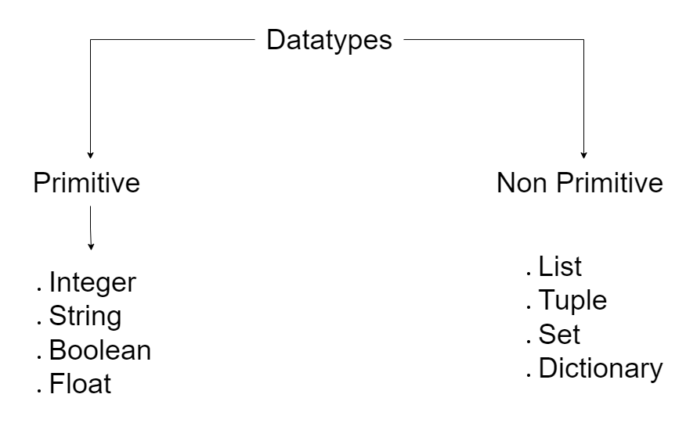
Python For Beginners
Datatypes
1
2
16th September, 2024
3
4

Slide 4
Python for Beginners
List, Tuples, Sets
1
List
A Python list is an ordered, mutable collection of items that allows duplicates.
Mutable: Elements can be changed.
Ordered: Items maintain their sequence.
Allows duplicates.
Uses Square Brackets ‘[]’ #E.g: [1, ‘two’, 3.0, True]
2
Tuples
A tuple is an ordered, immutable collection of items that also allows duplicates.
Immutable: Elements cannot be changed.
Ordered: Items maintain their sequence.
Allows duplicates.
Uses Parenthesis ‘()’ #E.g: (1, ‘two’, 3.0, True)
16th September, 2024
3
Sets
A set in Python is an unordered collection of unique elements, which means it does not allow duplicates and is not indexed.
Unordered: No defined order for elements.
Unique elements: Duplicates are automatically removed.
Mutable: Elements can be added or removed.
Uses Curly Braces ‘{}’ #E.g: {1, 3.0, 'two'}
4

Slide 5
Python for Beginners
Lists
1
A list in Python is a mutable, ordered collection of items. Lists can contain elements of different types, such as integers, strings, and other lists. They are defined using square brackets.
Mutable: Elements can be changed.
Ordered: Items maintain their sequence.
Allows duplicates.
Uses Square Brackets ‘[]’ #E.g: [1, ‘two’, 3.0, True]
Methods: Methods to work with python lists
Append(item): Adds an item to the end of the list.
Extend(iterable): Extends the list by appending elements from an iterable.
Insert(index, item): Inserts an item at a specified index.
Remove(item): Removes the first occurrence of an item.
Pop(index): Removes and returns the item at the specified index.
2
16th September, 2024
3
4

Slide 6
Python for Beginners
Tuple
1
A tuple in Python is an immutable, ordered collection of items. Like lists, tuples can contain elements of different types, such as integers, strings, and other tuples. They are defined using parentheses.
Immutable: Once created, elements cannot be changed.
Ordered: Items maintain their sequence.
Allows duplicates.
Uses Parentheses ‘()’: E.g: (1, 2, 3)
Methods:
Count(item): Returns the number of occurrences of an item in the tuple.
Index(item): Returns the index of the first occurrence of an item.
Since tuples are immutable, we can’t change the data of an tuple.
2
16th September, 2024
3
4

Slide 7
Python for Beginners
Sets
1
A set in Python is an unordered, mutable collection of unique items. Unlike lists and tuples, sets do not allow duplicate elements. They are defined using curly braces or the ‘set()’ function.
Mutable: Elements can be added or removed, but individual items cannot be changed.
Unordered: There is no guaranteed order of elements.
No Duplicates: Sets automatically remove duplicates.
Uses curly braces ‘{}’
Methods:
Add(item): Adds an item to the set. Example: s.add(4)
Update(iterable): Adds elements from an iterable (like a list or another set) to the set. Example: s.update([5, 6])
Remove(item): Removes the specified item. Raises a KeyError if the item does not exist. Example: s.remove('apple’)
Pop(): Removes and returns an arbitrary element from the set. Raises a KeyError if the set is empty. Example: s.pop()
2
16th September, 2024
3
4

Slide 8
Python for Beginners
1
Dictionaries
A dictionary in Python is an unordered collection of data stored in key-value pairs. Each key in a dictionary must be unique, and each key is associated with a value. Dictionaries are mutable, meaning the data can be modified after creation, and are optimized for retrieving values using their keys. They are created using curly braces ‘{}’ , with each key and its corresponding value separated by a colon.
Unordered: Items do not maintain any specific order.
Unique Keys: Each key must be unique, but values can repeat.
Mutable: You can add, remove, or change items in a dictionary.
Key-Value Pairs: Each element is a pair of a key and its associated value.
Example:
{
“name”: “John Doe”,
“age”: 20,
“major”: “CS”
}
2
16th September, 2024
3
4

Slide 9
Python For Beginners
Try and Except Block
1
A Try-Except block in Python is a control structure used to handle exceptions, which are runtime errors that may occur during the execution of a program. It allows the programmer to attempt a block of code (the ‘try’ block) and specify one or more exception-handling routines (the ‘except’ blocks) to manage specific errors if they occur. This prevents the program from crashing and provides a way to gracefully handle errors and manage exceptional situations.
Error Handling: Handles runtime errors to prevent program crashes.
Multiple Excepts: Use multiple ‘except’ blocks for different exceptions.
Else Clause: Runs if no exceptions occur in the ‘try’ block.
Finally, Clause: Executes code no matter what, for cleanup purposes.
try:
# Do something
except:
# Handle Error
2
16th September, 2024
3
4

Slide 10
Build a simple contact management system in Python. Your task is to implement the following features using lists, tuples, sets, dictionaries, and try-except blocks:
Add Contacts:
Use a dictionary to store contact names (keys) and phone numbers (values).
Ask the user to input a contact name and phone number, then add this information to the dictionary.
View Contacts:
Display all contacts in the dictionary.
Use a list to store and display the names of all contacts in alphabetical order.
Search Contacts:
Ask the user to input a contact name to search for. Use a try-except block to handle cases where the contact is not found in the dictionary.
Unique Phone Numbers:
Convert the list of phone numbers from the dictionary to a set to remove any duplicate phone numbers.
Display the unique phone numbers.
Contact History:
Use a tuple to store the history of contact additions (name and phone number). Each time a new contact is added, store the information in the tuple and display the history.

